Slide 1
CS 499/CS 579: Enterprise Defense
Day 2: Core Concepts

Slide 2
Overview
Knowledge check
It’ll be fine, we promise…
Physical and logical network components

Slide 3
Question 1
What is a NIC?
What is a switch?
What is a router?
What do they have to do with one another?
Notes:
NIC = Network Interface Controller (hardware - connects computer to a network)
Switch = network hardware that connects devices on a network by using packet switching to receive and forward data
Router = like a switch, but also performs traffic directing functions; connects different IP networks together.

Slide 4
Question 2
Why would a web server interact with a database server?
Notes:
to present/collect/store data. Example: an online store

Slide 5


Question 3
What is VPN?
Why would you care about it?
(besides circumventing media restrictions)
Notes:
Virtual Private Network. Encrypted tunnel between two networks…

Slide 6
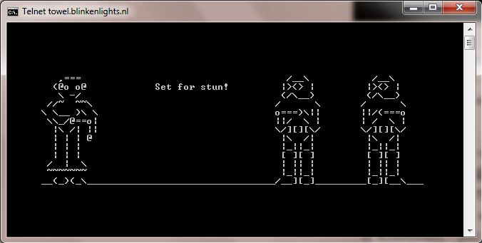
Question 4
What is telnet?
What is it used for (besides watching Star Wars)?
Notes:
bi-directional communication application/protocol.

Slide 7
Question 5
What is FTP?
Are there secure versions of it?
If so, what are they? How would you use them?
Notes:
File Transfer Protocol.
SFTP and FSTP

Slide 8
Question 6
Define “directory services” in the context of enterprise computing.
Notes:
Wikipedia def: a directory service or name service maps the names of network resources to their respective network addresses. It is a shared information infrastructure for locating, managing, administering and organizing everyday items and network resources, which can include volumes, folders, files, printers, users, groups, devices, telephone numbers and other objects

Slide 9
Question 7
What is SMTP?
What would you use it for?
Notes:
Simple Mail Transfer Protocol

Slide 10
Question 8
How does “The Internet” associate a numeric network address with a human readable name?
BONUS: why does it always break?
Notes:
Domain Name System (DNS)

Slide 11


Slide 12
Question 9
In the land of networking, what is a packet?
What does it do?
Where can I get some of this “packet” stuff?
Notes:
formatted unit of data carried by a packet-switching network

Slide 13

Question 10
How are computers assigned their addresses so they can find other computers and other computers can find them on the ?
Notes:
Manually or dynamically. If dynamically, they use the Dynamic Host Configuration Protocol.

Slide 14
Question 11
Describe the Address Resolution Protocol (ARP).
Why is it useful?
Notes:
Used to find the MAC address associated with an assigned IP address (so computers can talk to each other.)

Slide 15
Question 12
What is the difference between authentication and authorization?
Notes:
“Who are you?” vs. “What are you allowed to do?”

Slide 16

Question 13
What does SMB stand for?
How does it work?
BONUS: Why does the image below make CCDC teams sad?
Notes:
Server Message Block. Communication protocol for sharing things.

Slide 17
Question 14
In the land of networking, what is the meaning of “physical segmentation”?
What about “logical segmentation”?
Notes:
Dividing a network up into different subnets. This is either done physically, using hardware such as a firewall, or virtually, using VLANS.

Slide 18
Question 15
What is the difference between HTTP and HTML?
Notes:
Hypertext Transfer Protocol
Hypertext Markup Language

Slide 19

Question 16
Besides stacked lamps, what is a LAMP stack?
Bet your brain adds the sound effects
Notes:
Linux, Apache, MySQL, and PHP

Slide 20
Question 17
What is the “Lightweight Directory Access Protocol” (LDAP)?
Notes:
An open directory service protocol that runs over the TCP/IP stack.

Slide 21

Question 18
What is “ping” and how does it work?
Notes:
program to verify connectivity to another TCP/IP computer using Internet Control Message Protocol (IMCP) echo requests.

Slide 22
Question 19
What is “traceroute”?
Notes:
Command that determines the path taken to a destination by sending ICMP echo Request or ICMPv6 messages to the destination with incrementally increasing time to live (TTL) field values.

Slide 23
Question 20
At a high level, what is TCP/IP?
Notes:
The internet protocol suite. It is a framework for organizing the set of communication protocols used in the Internet and similar computer networks.

Slide 24
